Slide 1
Health Predictor:Early Lifestyle Disease Prediction
PIP104 University Project-II
Review-0
Batch Number: CSD13
Roll Number | Student Name
FAIZ KHAN | 20201CSD0115
JEEVITH JOSEPH | 20201CSD0111
TEJAS GOWDA | 20201CSD0072
Under the Supervision of,
Dr. V Chandra Sekar
School of Computer Science & Engineering
Presidency University

Slide 2
Introduction
In an era where data and technology are transforming every aspect of our lives, healthcare is no exception. With the rising prevalence of lifestyle-related diseases, such as diabetes, heart disease, and obesity, the need for innovative and cost-effective preventive healthcare solutions has never been more pressing. Early detection and intervention are key to reducing the human and economic toll of these diseases. This project sets out to explore a novel approach to healthcare that harnesses the power of detailed demographic and vital statistics to predict the likelihood of lifestyle diseases, enabling timely interventions and substantial cost savings in the long run.
Lifestyle diseases are characterized by their strong association with lifestyle choices, such as diet, exercise, and stress management. It is well-established that early identification of risk factors and lifestyle modifications can significantly reduce the incidence of these diseases. The traditional healthcare system, however, is often geared towards treating diseases once they manifest, incurring substantial costs for patients, providers, and society as a whole.
In this project, we will delve into the methods and technologies necessary to harness the potential of data-driven predictive modeling in healthcare. By integrating technology, data, and medical expertise, we aim to pave the way for a healthcare system that not only extends lives but also makes them healthier and more affordable. This proactive approach holds the promise of not only enhancing the quality of life for individuals but also reducing the economic burden of lifestyle diseases on healthcare systems worldwide.

Slide 3
Literature Review
Early prediction of lifestyle diseases has gained prominence in the healthcare domain due to the potential for reducing healthcare costs and improving patient outcomes. Several studies have explored the application of machine learning and data analytics in this context.
Predictive Models in Healthcare: Predictive modeling in healthcare has been widely researched and has demonstrated remarkable potential in forecasting the onset of various diseases. These models use historical patient data, including demographics and vital statistics, to identify risk factors and predict disease likelihood.[Sharma, M., & Majumdar, P. K. (2009)]
Leveraging Demographic and Vital Statistics: Demographic and vital statistics, such as age, gender, BMI, blood pressure, and cholesterol levels, have been identified as valuable predictors for lifestyle diseases. Research indicates that integrating these data into predictive models enhances their accuracy.[Sayali Ambekar and Dr. Rashmi Phalnikar (2018)]
Cost Reduction Through Early Intervention: Several studies have highlighted the significant cost benefits associated with early disease prediction. By identifying individuals at risk, healthcare providers can implement preventive measures, reducing the need for expensive treatments and hospitalizations.
Challenges and Limitations: Challenges such as data quality, model interpretability, and the need for continuous model refinement are acknowledged in the literature. Addressing these challenges is crucial to ensure the success of predictive healthcare models.

Slide 4
Proposed Method : Developing a Website for Lifestyle Disease Prediction
Data Collection and Preparation:
Gather a comprehensive dataset that includes demographic information and vital statistics of individuals, along with their lifestyle disease status (e.g., diabetes, heart disease).
Ensure data quality, accuracy, and privacy compliance by anonymizing and securing sensitive information.
Split the dataset into training and testing sets for model development and evaluation.
Feature Selection and Engineering:
Identify relevant features from the dataset, such as age, gender, BMI, blood pressure, cholesterol levels, and lifestyle habits (e.g., smoking, physical activity, diet).
Perform feature engineering to create new variables or transform existing ones, if necessary, to improve predictive accuracy.
Machine Learning Model Development:
Implement machine learning algorithms suitable for classification tasks, such as logistic regression, decision trees, random forests, or support vector machines.
Train the models on the training dataset using the selected features.
Evaluate model performance using metrics like accuracy, precision, recall, and F1-score, and select the most appropriate model.
Website Integration:
Develop a user-friendly website that incorporates a user friendly interface for interacting with users.
Implement a natural language processing (NLP) module to understand user queries and requests.
Allow users to input their parameters, including age, gender, BMI, and other vital statistics.
Disease Prediction Module:
Integrate the trained machine learning model into the website interface.
On user input, pass the parameters to the model, which will then predict the likelihood of lifestyle diseases based on the provided data.
Provide users with a clear and interpretable prediction, indicating their risk of developing specific diseases.

Slide 5
Objectives
Overall Objectives:
Empower Personalized Healthcare: Develop a platform that empowers individuals to take control of their health by providing personalized predictions and actionable insights regarding lifestyle diseases.
Cost-Effective Prevention: Create a cost-effective healthcare solution that reduces the financial burden on individuals and healthcare systems by preventing disease onset and costly treatments.
Data-Driven Healthcare: Leverage the power of data analytics and machine learning to pioneer an innovative approach to healthcare that emphasizes early prediction and prevention.
Specific Objectives :
Comprehensive Data Acquisition: Acquire a comprehensive dataset, including diverse demographic information and vital statistics, to underpin accurate disease prediction.
Optimized Feature Selection: Identify and select the most influential features to enhance the precision of lifestyle disease predictions.
User-Centric Interface: Develop a user-centric website with a user friendly interface that enables effortless data input and real-time prediction retrieval.
Intuitive User Experience: Implement natural language processing (NLP) to ensure a user-friendly and intuitive experience while interacting with the website.

Slide 6
Methodology
1. Data Collection and Preprocessing:
Data Sourcing: Gather a comprehensive dataset that includes demographic details, vital statistics, lifestyle habits, and the binary classification of lifestyle disease status (e.g., presence/absence of diseases) from diverse sources, including medical records, surveys, and relevant databases.
Data Cleaning: Perform data cleaning to address missing values, outliers, and inconsistencies. This includes data imputation, removal of duplicates, and ensuring data integrity.
Data Privacy: Implement stringent data privacy measures to ensure user data protection and regulatory compliance. Anonymize and encrypt sensitive information to safeguard user privacy.
2. Feature Engineering:
Feature Selection: Employ feature selection techniques to identify the most influential attributes for lifestyle disease prediction. Features may include age, gender, BMI, blood pressure, cholesterol levels, and lifestyle variables (e.g., smoking, physical activity, diet).
Feature Transformation: Apply necessary transformations to selected features to enhance their relevance and predictive power. For example, converting categorical variables into numerical values or scaling features.
3. Machine Learning Model Development:
Model Selection: Experiment with different machine learning algorithms suitable for binary classification tasks. These may include logistic regression, decision trees, random forests, support vector machines, and neural networks.
Training and Evaluation: Split the dataset into training and testing subsets to train and evaluate the models. Use cross-validation techniques to ensure robust model performance assessment.
4. Website Development & Integration:
Website Development: Build the website interface for user interaction, integrating natural language processing (NLP) capabilities. Ensure the website is user-friendly and can interpret user queries.
Model Integration: Integrate the selected machine learning model into the website, allowing it to accept user input and return predictions in real-time.

Slide 7
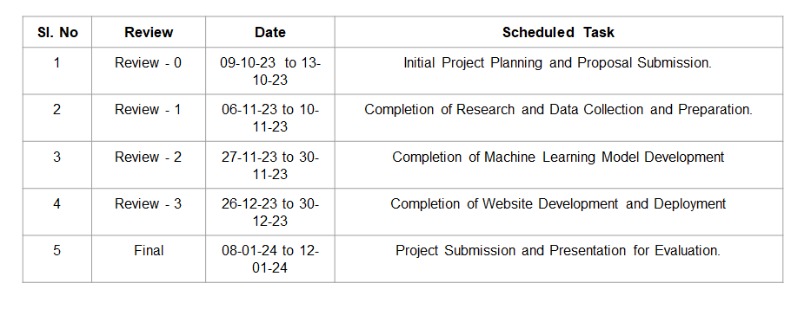
Timeline of Project

Slide 8
Expected Outcomes
Accurate Lifestyle Disease Predictions: The project will provide users with accurate predictions regarding their risk of developing specific lifestyle diseases based on their input data, helping individuals make informed decisions about their health.
Improved Health Awareness: Users will have access to educational resources that enhance their understanding of lifestyle diseases, risk factors, and preventive measures, promoting health literacy.
Enhanced User Engagement: Through a user-centric approach and an intuitive user interface, the project will attract and engage a diverse user base, encouraging regular utilization of the platform.
Cost Savings in Healthcare: By enabling early prediction and prevention of lifestyle diseases, the project can contribute to cost savings in healthcare by reducing the need for expensive treatments and hospitalizations.
Contribution to Research: The project will contribute to the field of predictive healthcare and preventive medicine, providing a valuable tool for healthcare professionals and researchers.

Slide 9
Conclusion
In an era marked by remarkable advancements in technology and an increasing focus on preventive healthcare, the development of a lifestyle disease prediction website represents a significant stride toward accessible, personalized, and data-driven health management. This project has culminated in the creation of a dynamic platform that empowers individuals to take proactive measures for their well-being and make informed decisions about their health.
The positive impact of this project extends far beyond technology. It represents a step toward healthier lives, more informed choices, and a future where healthcare is not just curative but profoundly preventive. The commitment to improving public health, cost savings, and enhancing user satisfaction underscores the significance of this endeavor. With each prediction, each piece of health education, and each user empowered, we are collectively working toward a healthier, more informed, and more resilient society.
In closing, this lifestyle disease prediction website is not just a project; it is a testament to the power of technology to improve lives, reduce the burden of disease, and empower individuals to embrace healthier, more proactive lifestyles. It is a step into the future of healthcare, where prevention is paramount, and knowledge is a potent tool.

Slide 10
References
Sharma, M. and Majumdar, P.K. (2009). "Occupational lifestyle diseases: An emerging issue." Indian Journal of Occupational and Environmental Medicine, 13(3), 109–112.
Anand, A. and Shakti, D. (2015). "Prediction of diabetes based on personal lifestyle indicators." In Next Generation Computing Technologies (NGCT), 2015 1st International Conference, 673–676. IEEE.
Sayali Ambekar and Dr. Rashmi Phalnikar (2018). "Disease prediction by using machine learning." International Journal of Computer Engineering and Applications, 12, 1–6.
Han Y, Han M, Lee S, Sarkar AM, Lee YK. "A framework for supervising lifestyle diseases using long-term activity monitoring." Sensors (Basel). 2012;12(5):5363-79. doi: 10.3390/s120505363. Epub 2012 Apr 26. PMID: 22778589; PMCID: PMC3386688.

Slide 11
Thank You

